Slide 1
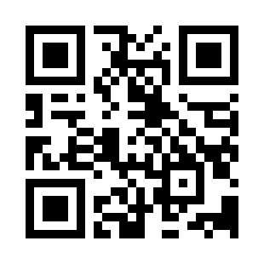
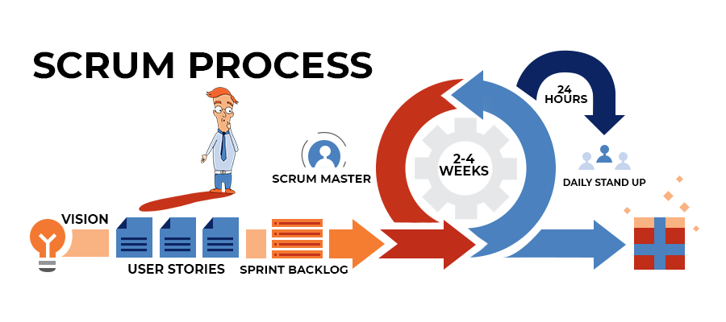
Scrum Development Process Quiz
https://bit.ly/2ZZKCJ7

